Slide 1
Lecture 5. Model training

Slide 2


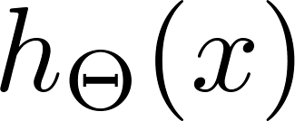

MLP review
Layer 1
Layer 2
Layer 3
Layer 4

Slide 3
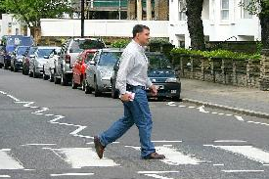

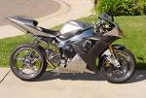
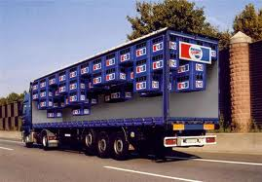
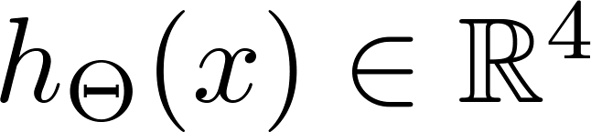
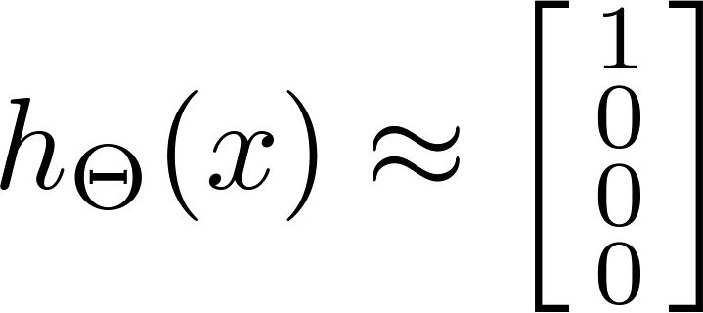

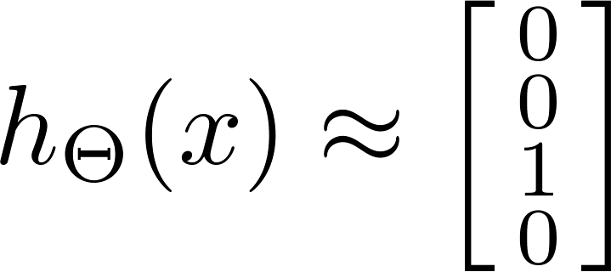
Multi-class classification
Pedestrian
Car
Motorcycle
Truck
Want , , , etc.
when pedestrian when car when motorcycle

Slide 4
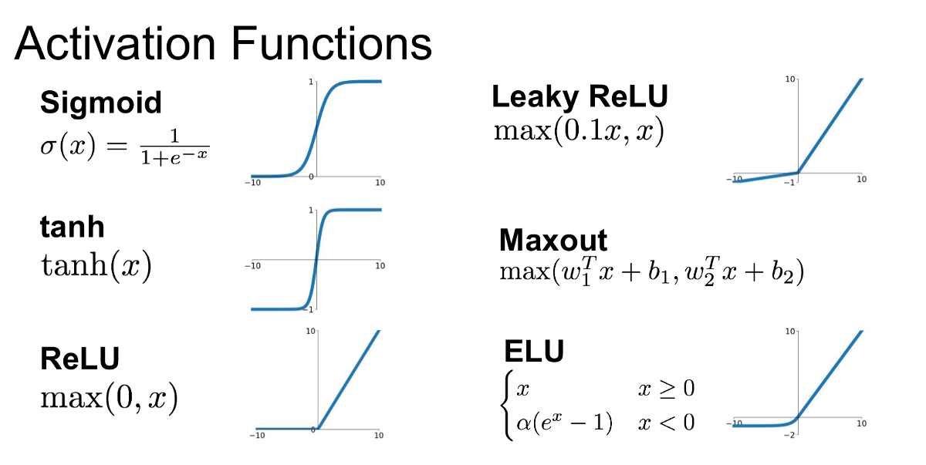

Slide 5
Classification peformance metrics

Slide 6
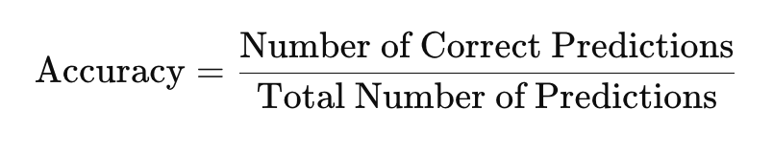

Slide 7



Cancer classification example
Train logistic regression model . ( if cancer, otherwise) Find that you got 1% error on test set.
(99% correct diagnoses / accuracy = 0.99)
But only 0.50% of patients have cancer.

Slide 8
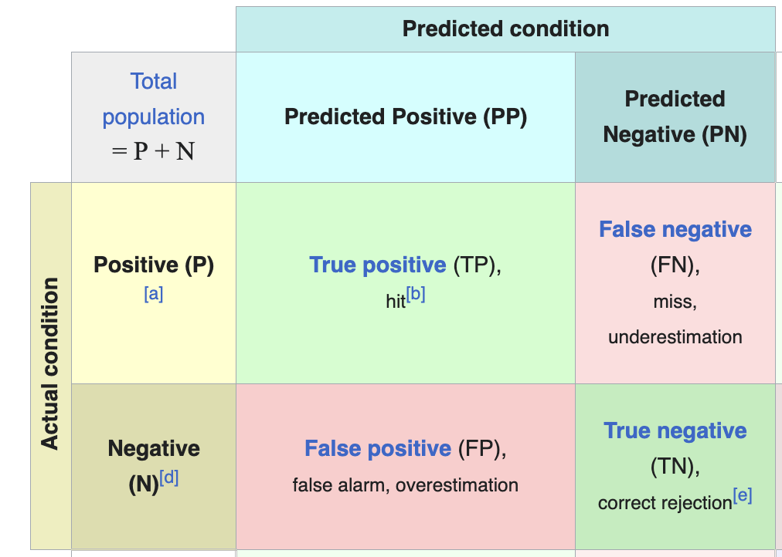
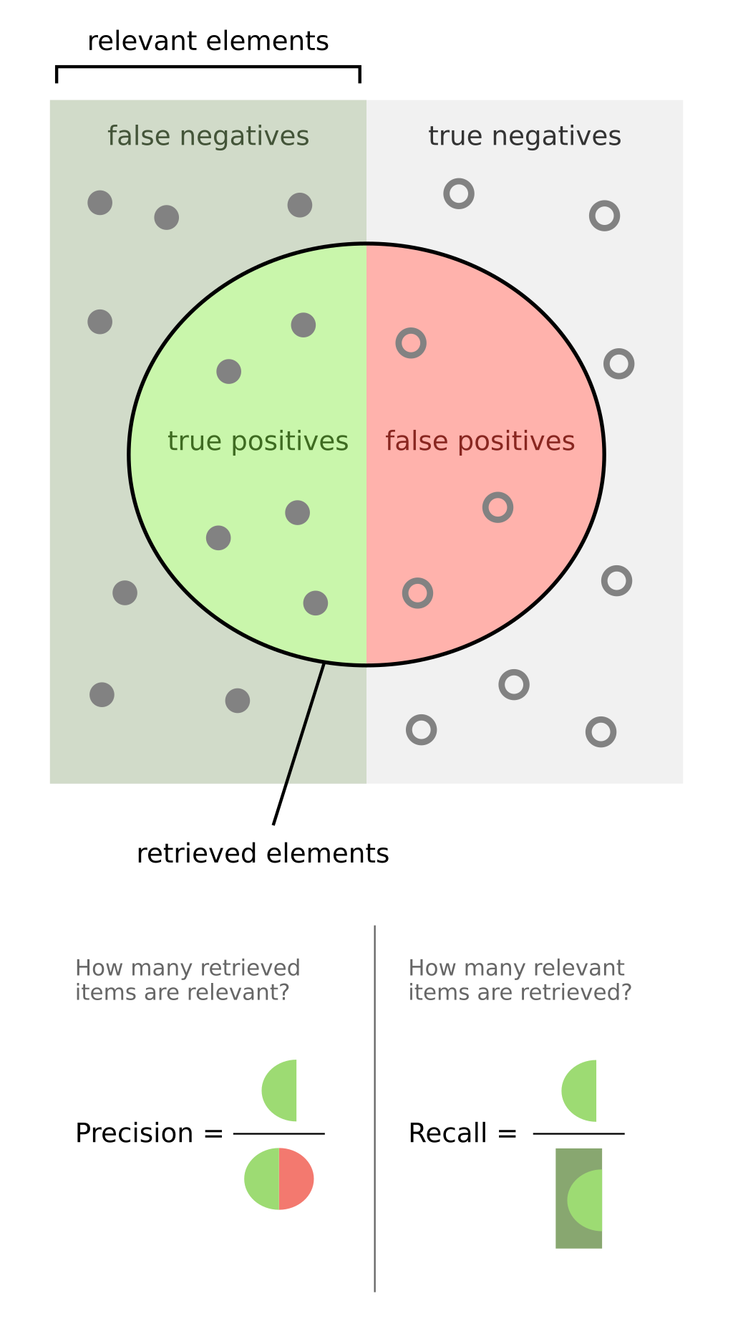
The confusion matrix

Slide 9
Precision/Recall
in presence of rare class that we want to detect
Precision
(Of all patients where we predicted , what fraction actually has cancer?)
Recall
(Of all patients that actually have cancer, what fraction did we correctly detect as having cancer?)

Slide 10
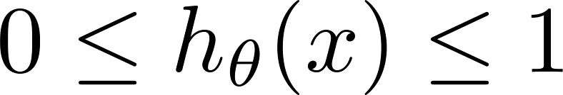



Trading off precision and recall
precision =
true positives
no. of predicted positive
Logistic regression:
Predict 1 if
Predict 0 if
recall =
true positives
no. of actual positive
Suppose we want to predict (cancer)
only if very confident.
1
Precision
0.5
Suppose we want to avoid missing too many cases of cancer (avoid false negatives).
0.5
1
Recall
More generally: Predict 1 if threshold.

Slide 11
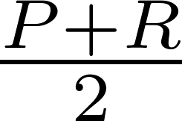
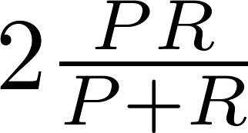
F₁ Score (F score)
How to compare precision/recall numbers?
 | Precision(P) | Recall (R) | Average | F₁ Score
Algorithm 1 | 0.5 | 0.4 | 0.45 | 0.444
Algorithm 2 | 0.7 | 0.1 | 0.4 | 0.175
Algorithm 3 | 0.02 | 1.0 | 0.51 | 0.0392
Average:
F₁ Score:

Slide 12
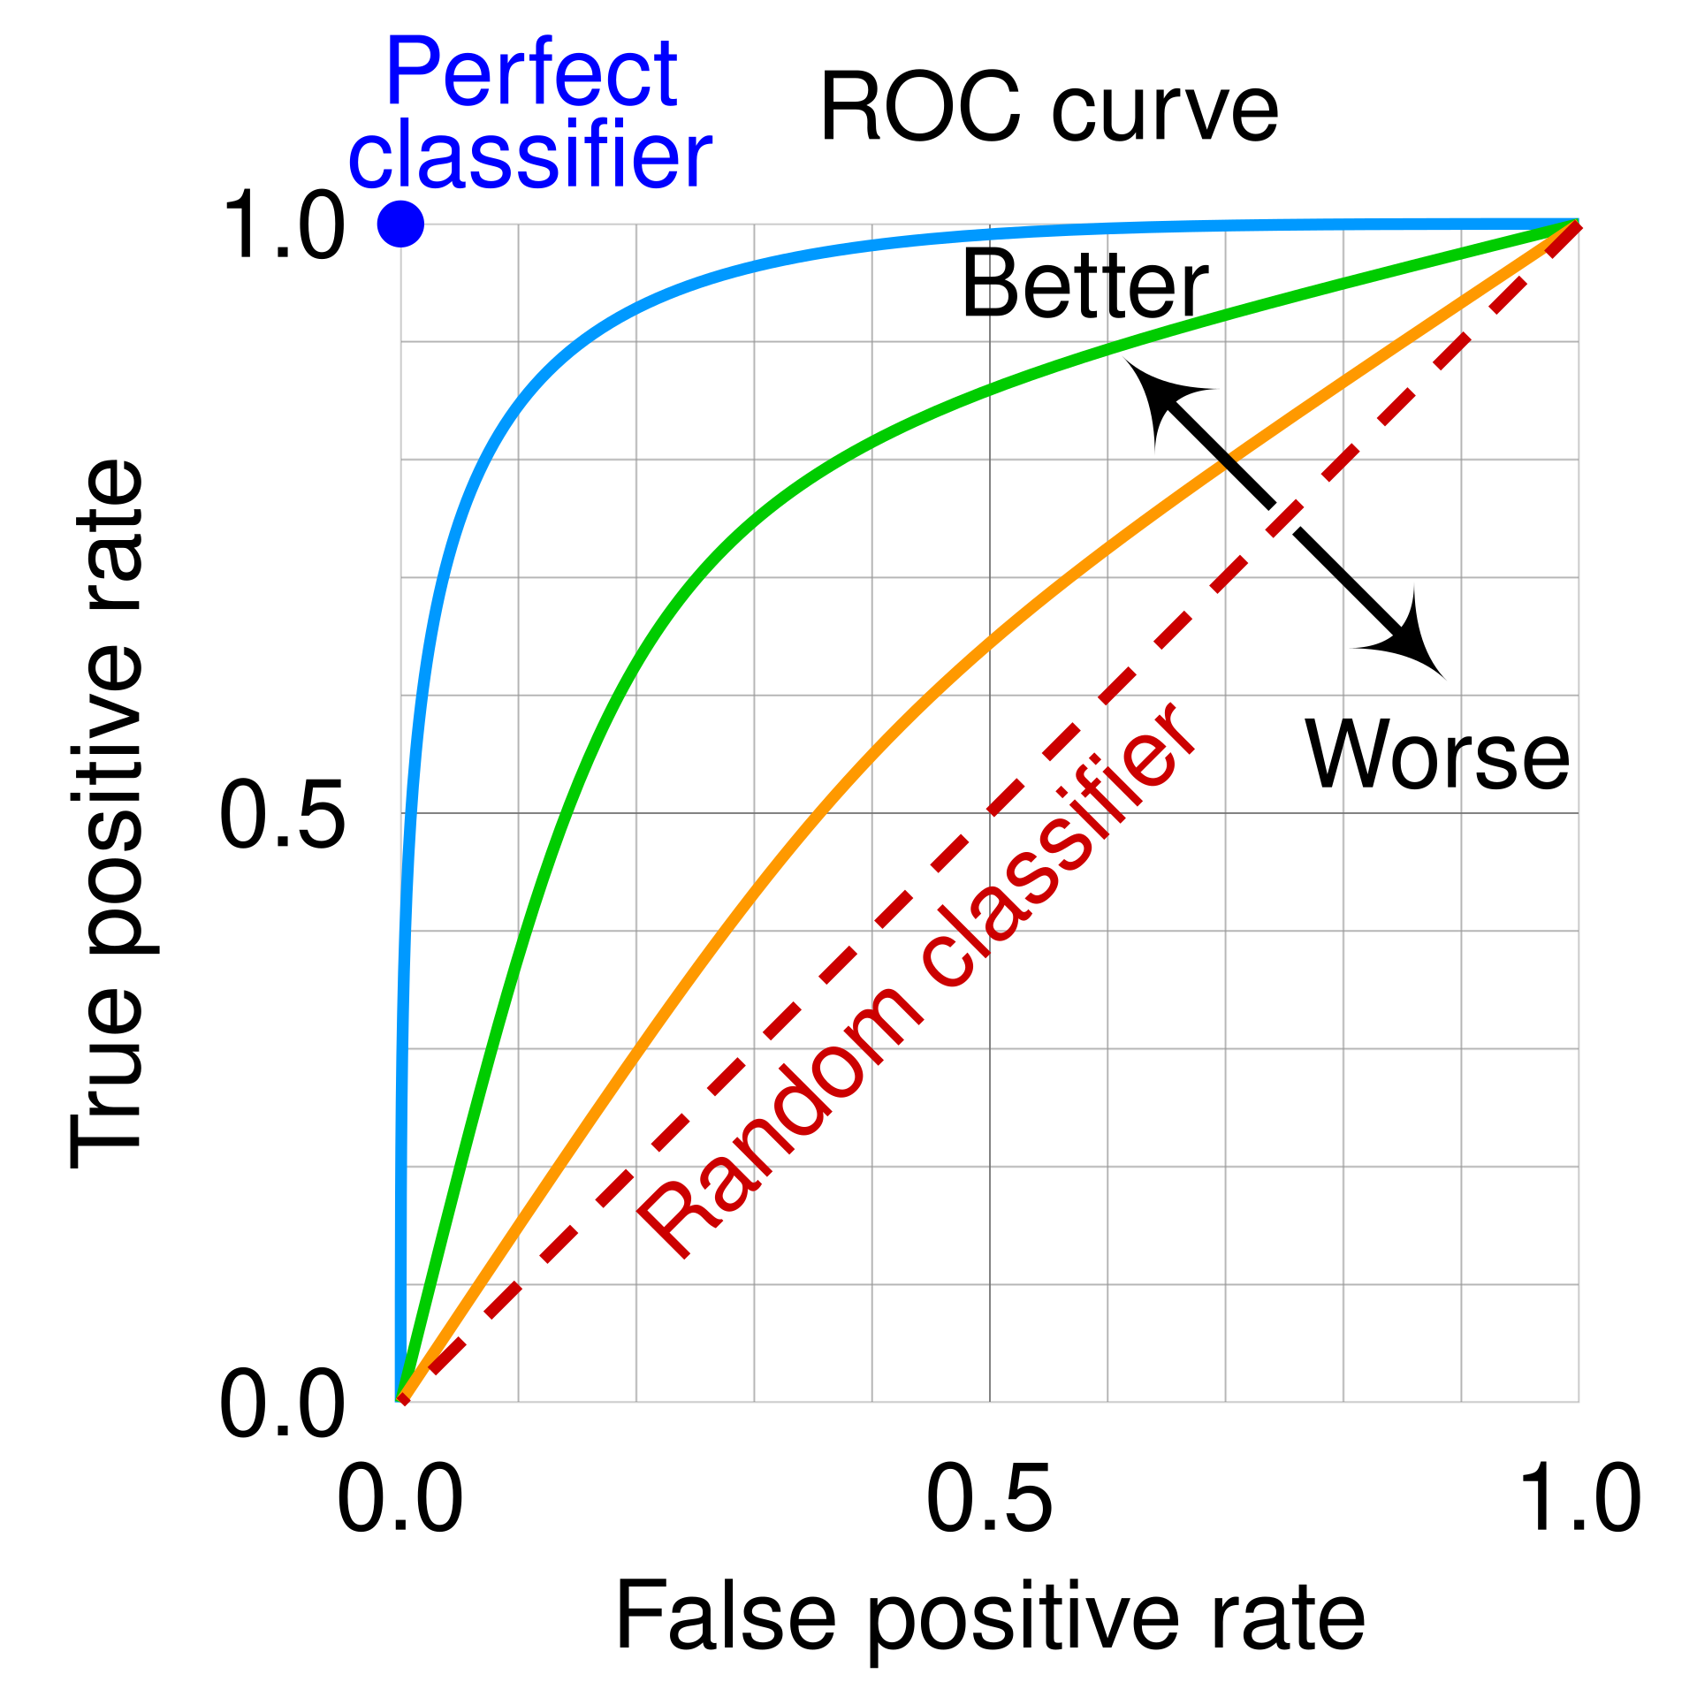
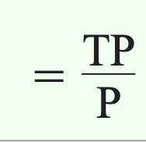
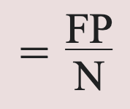
Receiver-operating characteristic curve (ROC)
True positive rate
False positive rate

Slide 13
The problem of overfitting
Regularization

Slide 14
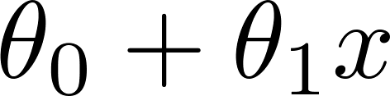
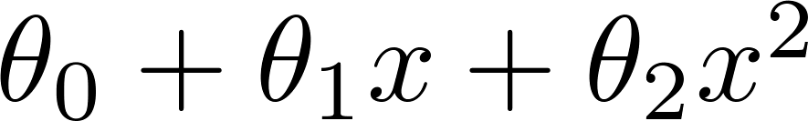
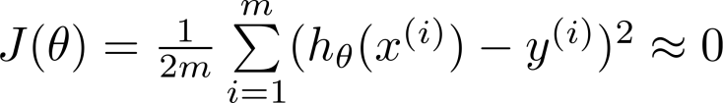
Example: Linear regression (housing prices)
Price
Price
Price
Size
Size
Size
Overfitting: If we have too many features, the learned hypothesis may fit the training set very well ( ), but fail to generalize to new examples (predict prices on new examples).

Slide 15
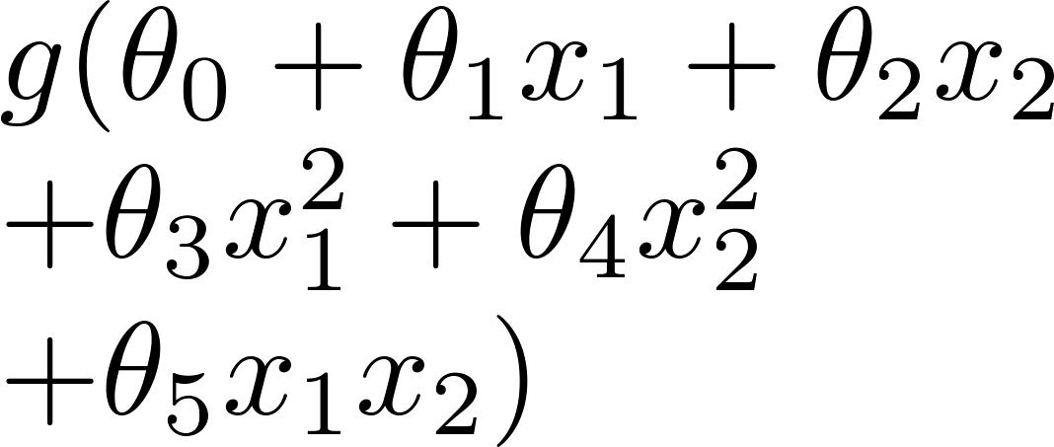
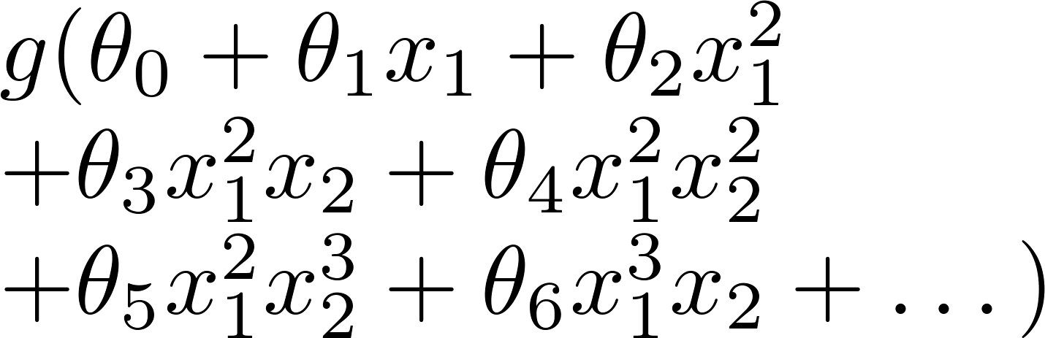
Example: Logistic regression
x₂
x₂
x₂
x₁
x₁
x₁
( = sigmoid function)

Slide 16






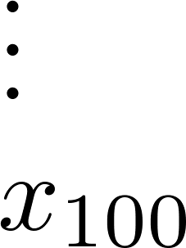
Addressing overfitting:
size of house
no. of bedrooms
no. of floors
age of house
average income in neighborhood
kitchen size

Slide 17


Addressing overfitting:
Options:
Reduce number of features.
Manually select which features to keep.
Model selection algorithm (later in course).
Regularization.
Keep all the features, but reduce magnitude/values of parameters .
Works well when we have a lot of features, each of which contributes a bit to predicting .

Slide 18
Cost function
Regularization

Slide 19


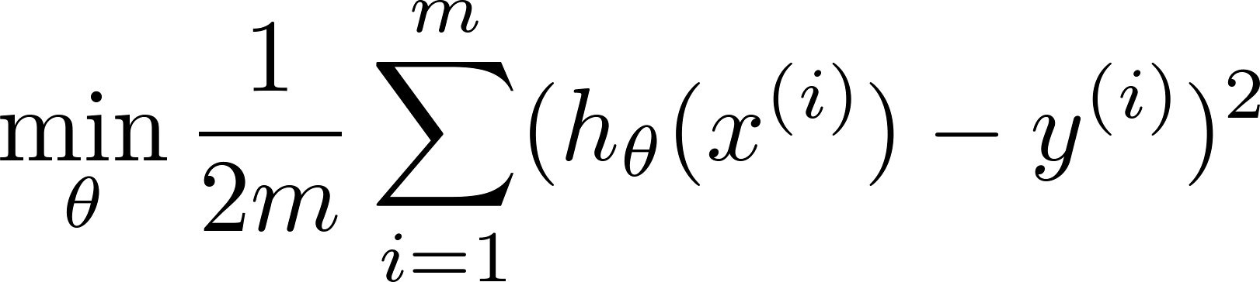
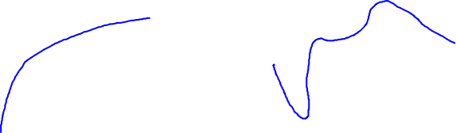
Intuition
Price
Price
Size of house
Size of house
Suppose we penalize and make , really small.

Slide 20
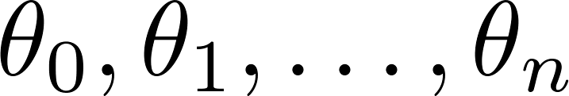
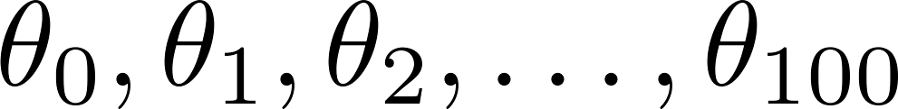
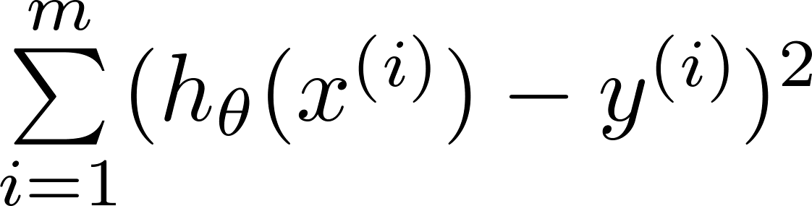
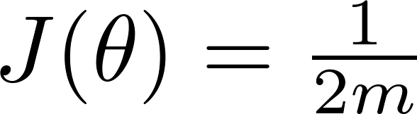
Regularization.
Small values for parameters
“Simpler” hypothesis
Less prone to overfitting
Housing:
Features:
Parameters:

Slide 21
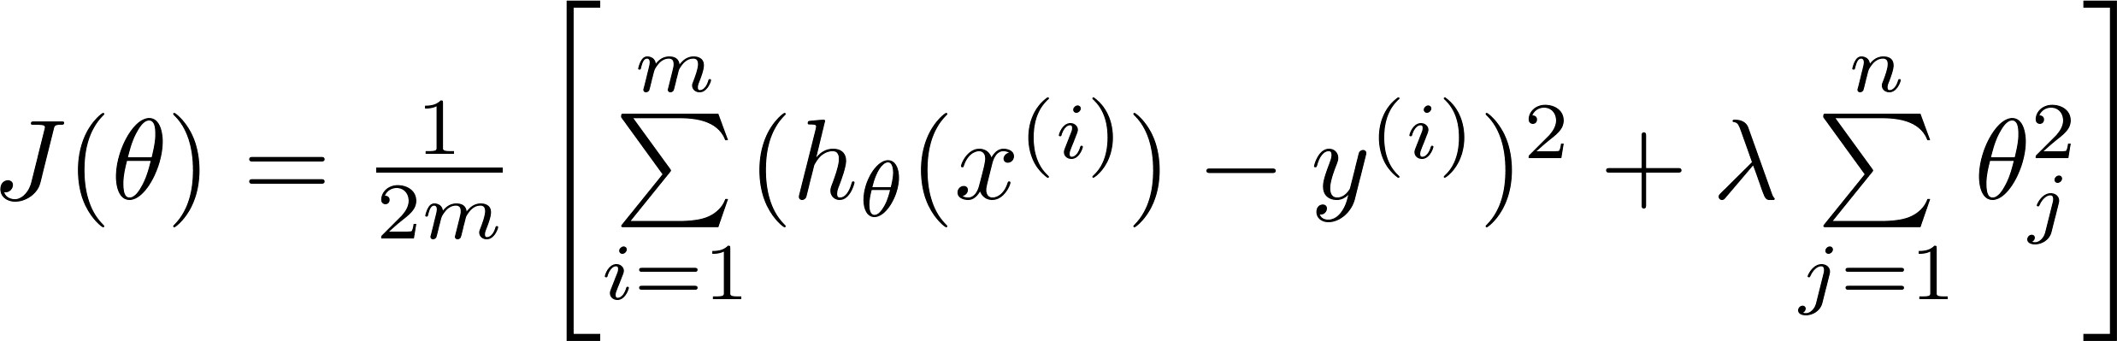
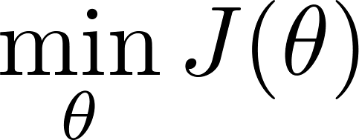
Regularization.
Price
Size of house

Slide 22


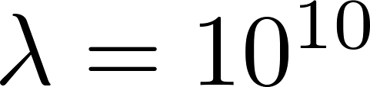
In regularized linear regression, we choose to minimize
What if is set to an extremely large value (perhaps for too large for our problem, say )?
Price
Size of house

Slide 23
In regularized linear regression, we choose to minimize
What if is set to a very small value?
Price
Size of house

Slide 24
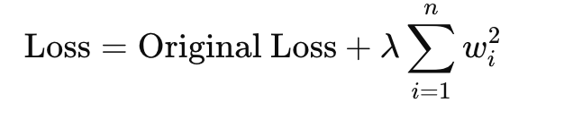
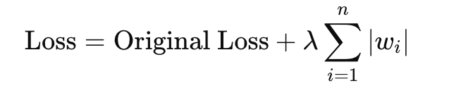
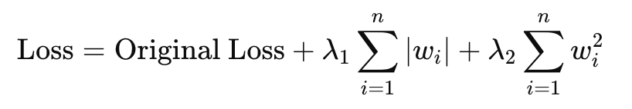
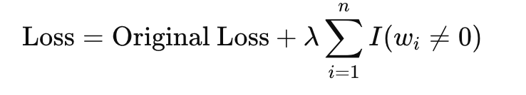
L2 Regularization (Ridge)
L1 Regularization (Lasso)
Elastic Net
L0 Regularization (L0 Norm)

Slide 25
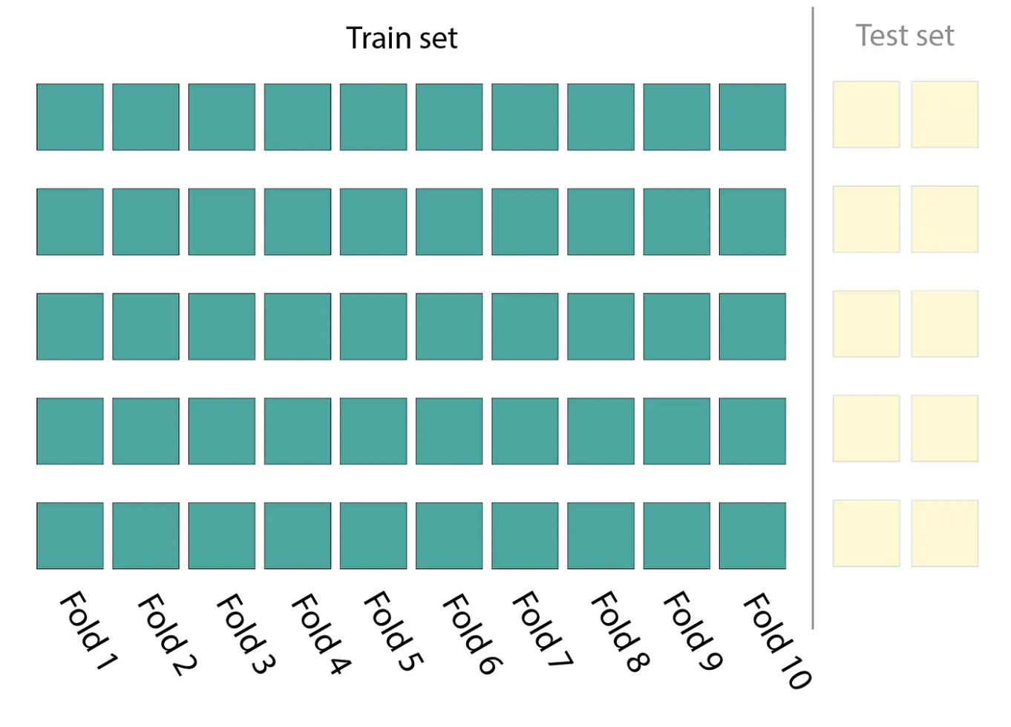
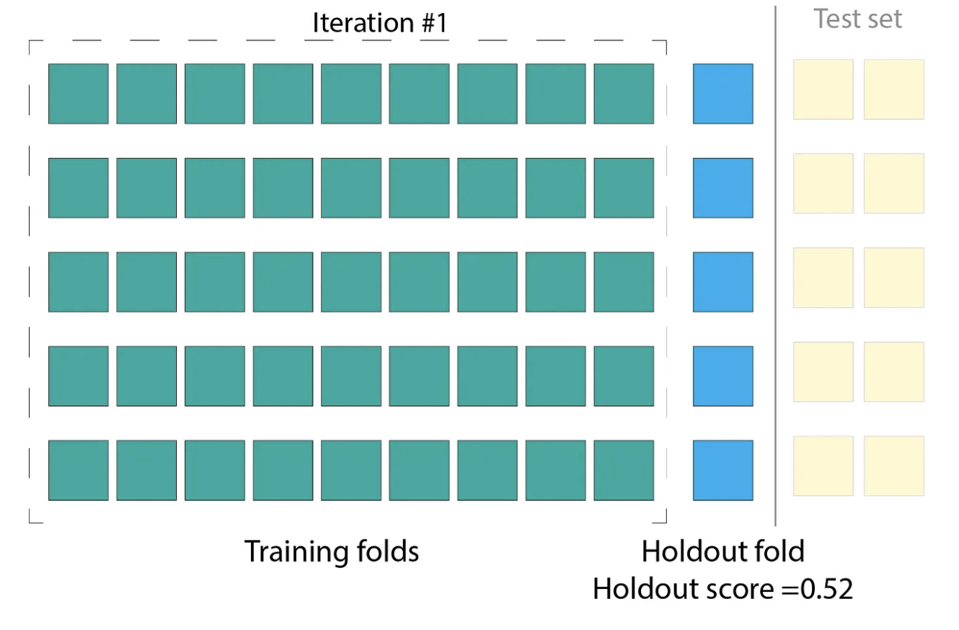
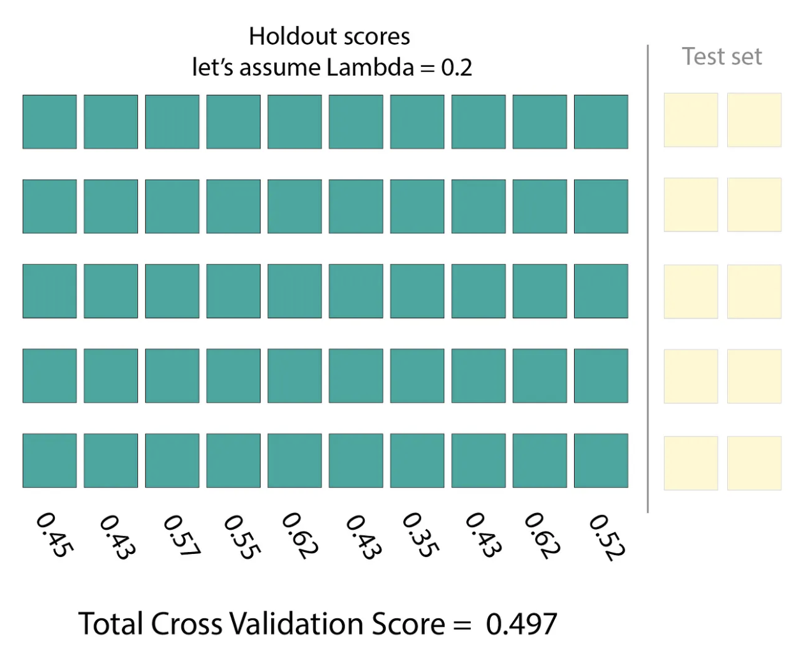
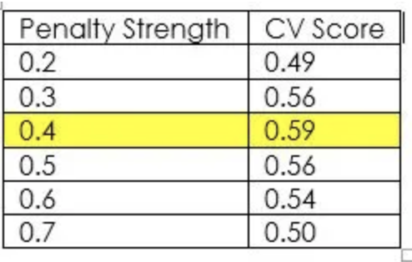
Pick the best regularization parameter with cross validation

Slide 26
Backpropagation algorithm
Neural Networks: Learning

Slide 27
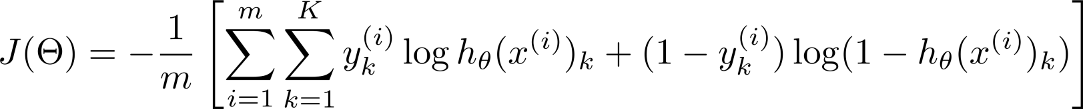
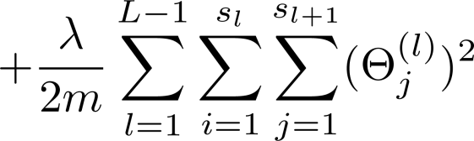
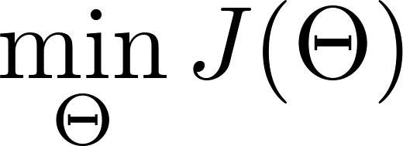
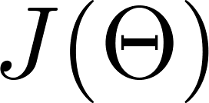
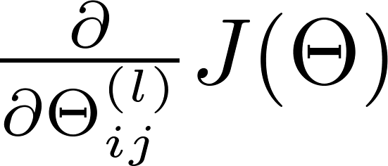
Gradient computation
Need code to compute:

Slide 28
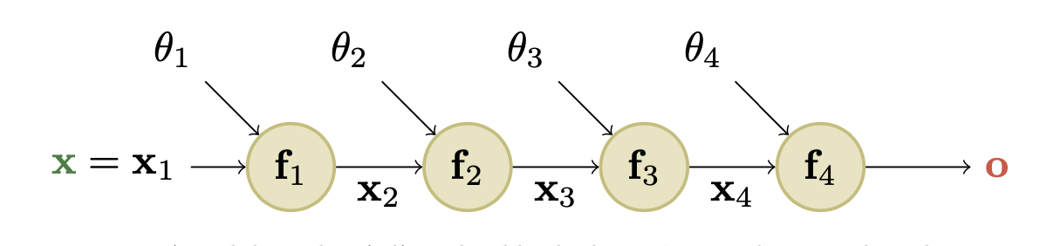
Forward Propagation

Slide 29
Back Propagation (backprop)
Additional reading: Murphy 13.3

Slide 30
Putting it together
Neural Networks: Learning

Slide 31

Training a neural network
Pick a network architecture (connectivity pattern between neurons)
No. of input units: Dimension of features
No. output units: Number of classes
Reasonable default: 1 hidden layer, or if >1 hidden layer, have same no. of hidden units in every layer (usually the more the better)

Slide 32
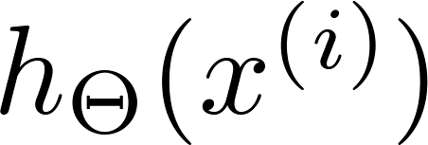

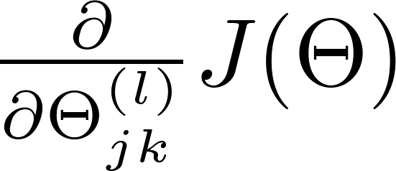
Training a neural network
Randomly initialize weights
Implement forward propagation to get for any
Implement code to compute cost function
Implement backprop to compute partial derivatives
for i = 1:m
Perform forward propagation and backpropagation using example

Slide 33

Training a neural network
Use gradient descent or advanced optimization method with backpropagation to try to minimize as a function of parameters

Slide 34
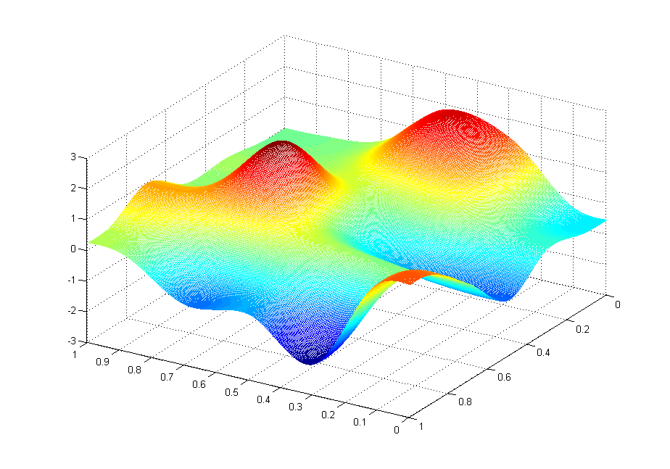



Slide 35
